Slide 1

REMOTE BACKUP UTILITY
PROJECT
Sprint 2
-Presentation by
Group 4
Mentor: Shankar Sir

Slide 2

CONTENTS
Introduction
DFD Diagram
Functions used in the Program
Brief Description of Code
Testing
Program Output

Slide 3
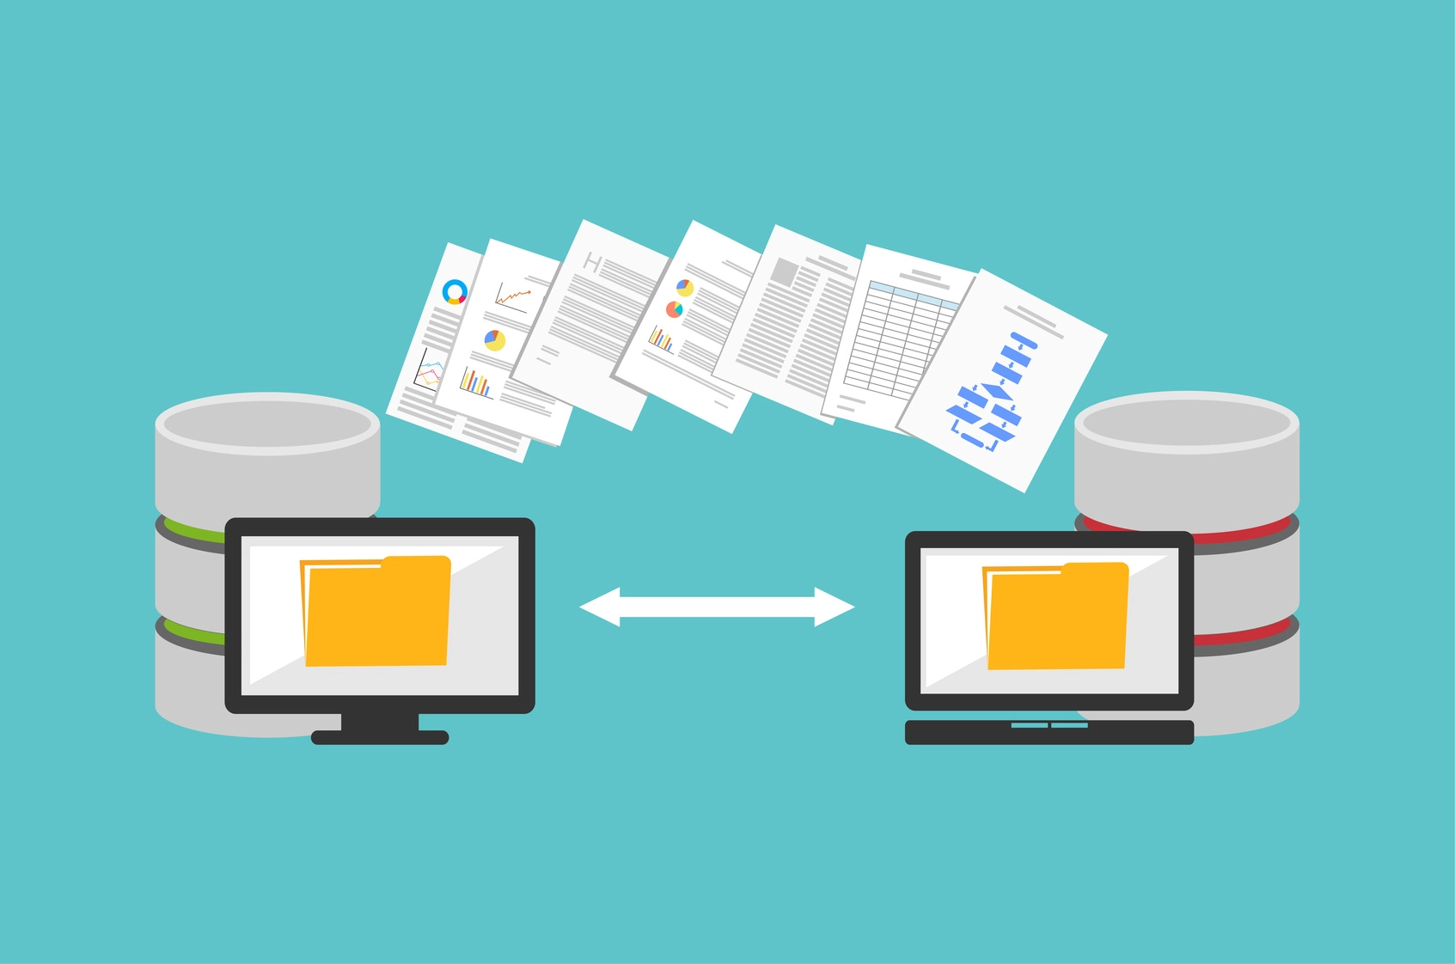
INTRODUCTION
Performing system backup is crucial when it comes to managing important files on a regular basis.
A backup client is the source computer or node within a backup process that contains the data to be backed up on a destination storage server.
A backup client is generally the end user’s computer or server in a network enabled backup environment.

Slide 4
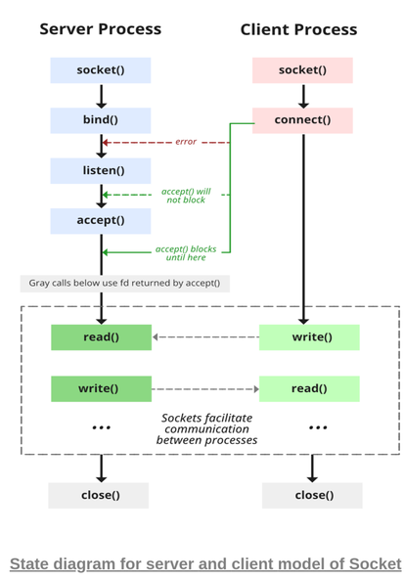
Concept used :
Socket programming
Socket programming is a way of connecting two nodes on a network to communicate with each other.
One socket(node) listens on a particular port at an IP, while the other socket reaches out to the other to form a connection.
The server forms the listener socket while the client reaches out to the server.

Slide 5
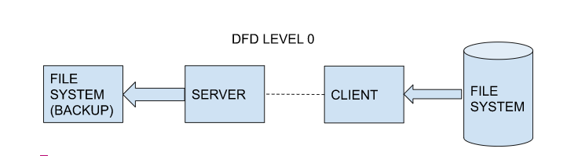
DATA FLOW DIAGRAM (Level 0)

Slide 6
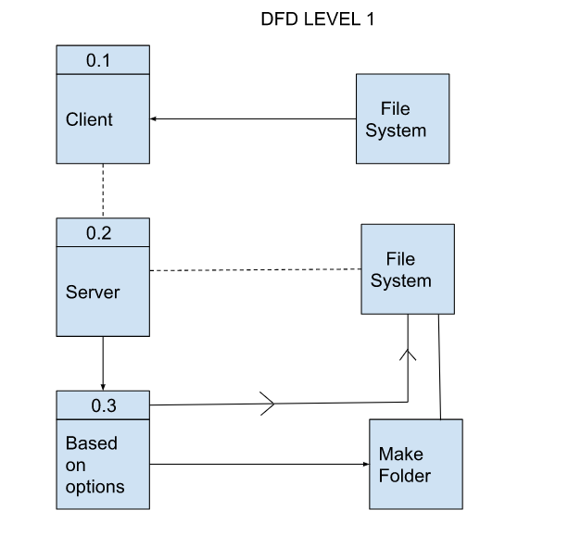
DATA FLOW DIAGRAM (Level 1)

Slide 7
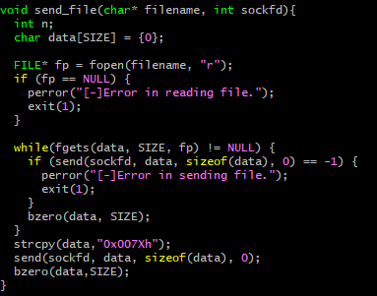
SEND FILE FUNCTION
send_file() function
The send file function takes 2 parameters the filename and the socketID.
If the file exists it opens the file in read mode and reads the contents of the file.
Then with help of send() function, it sends the contents of the file to the server using the specified socketID

Slide 8
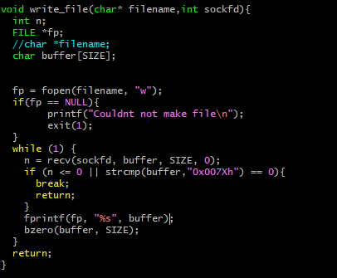
WRITE FILE FUNCTION
write_file() function
The write file function takes 2 parameters the filename and the socketID.
It opens the file in write mode and writes the contents of the received data with the help of recv() specified socketID.

Slide 9
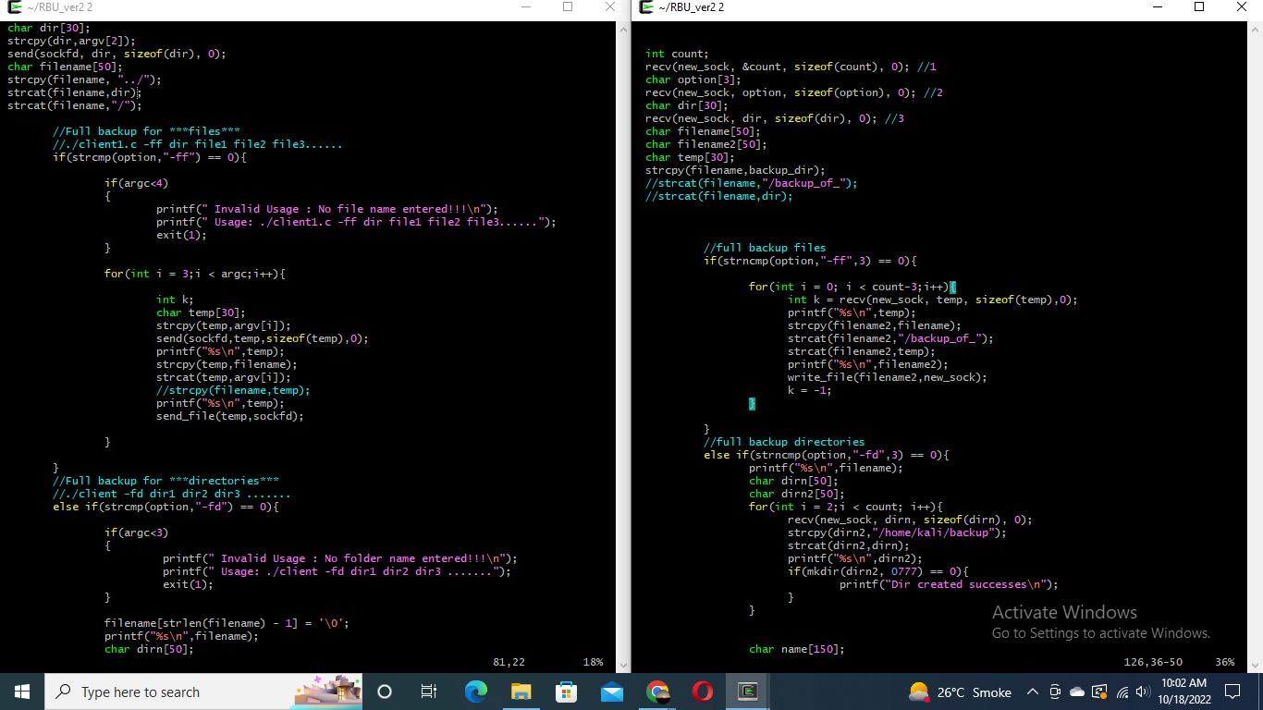
BRIEF DESCRIPTION OF CODE FOR FULL-BACKUP(FILES)
./client.c [-ff] dir file1 file2 file 3…..
server
client

Slide 10
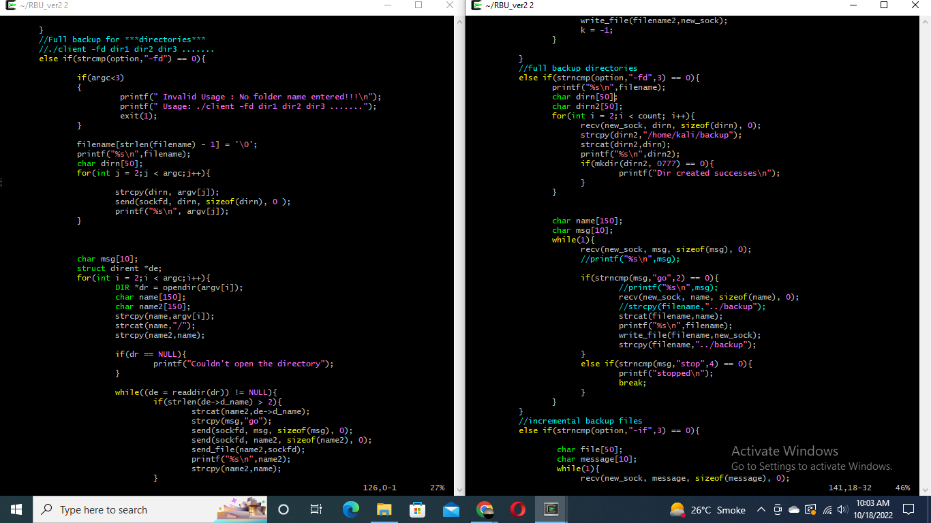
BRIEF DESCRIPTION OF CODE FOR FULL-BACKUP(DIRECTORIES)
./client.c [-fd] dir1 dir2 dir3
server
client

Slide 11
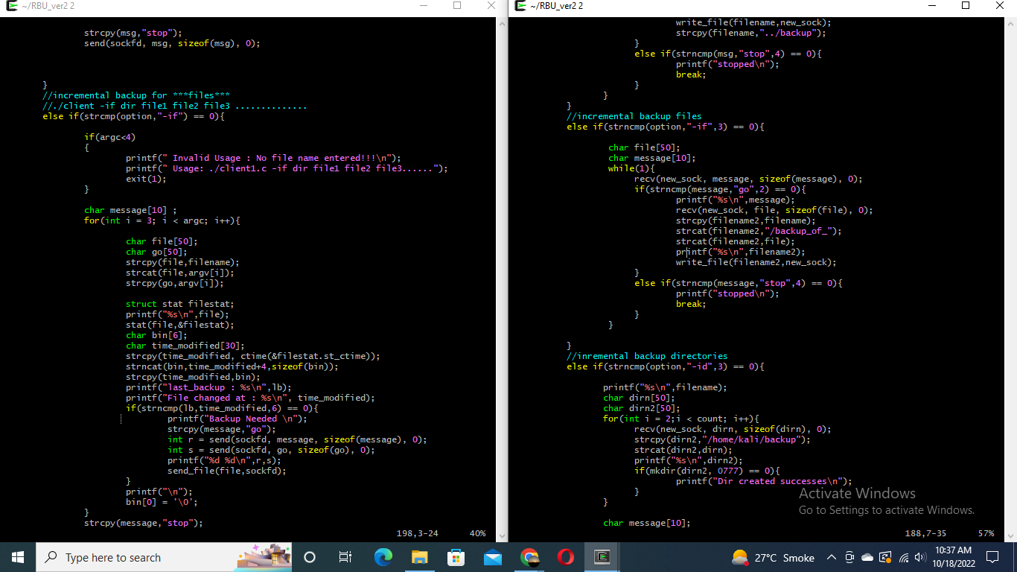
BRIEF DESCRIPTION OF CODE FOR INCREMENTAL-BACKUP(FILES)
./client.c [-if] file1 file2 files… 3…..
server
client

Slide 12
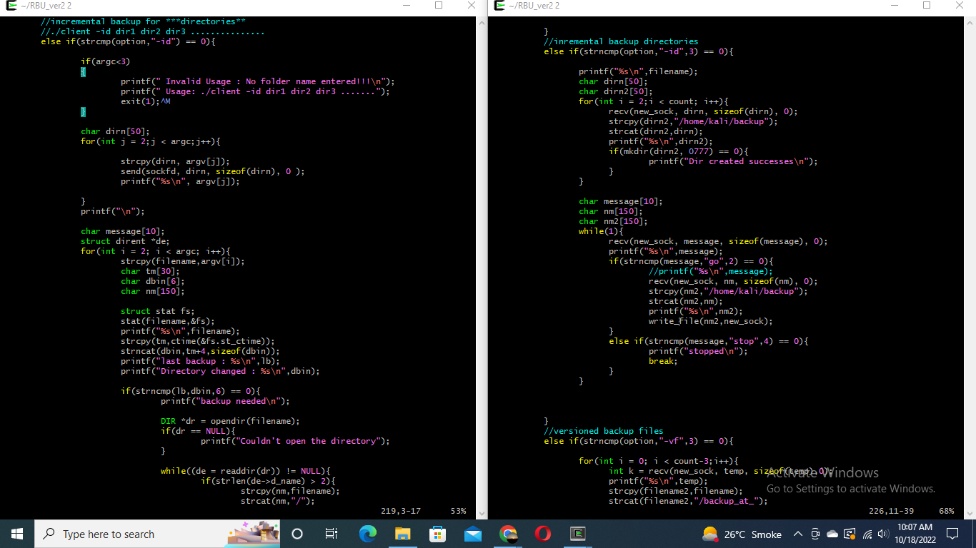
BRIEF DESCRIPTION OF CODE FOR INCREMENTAL-BACKUP(DIRECTORIES)
./client.c [-id] dir1 dir2 dir3..
server
client

Slide 13
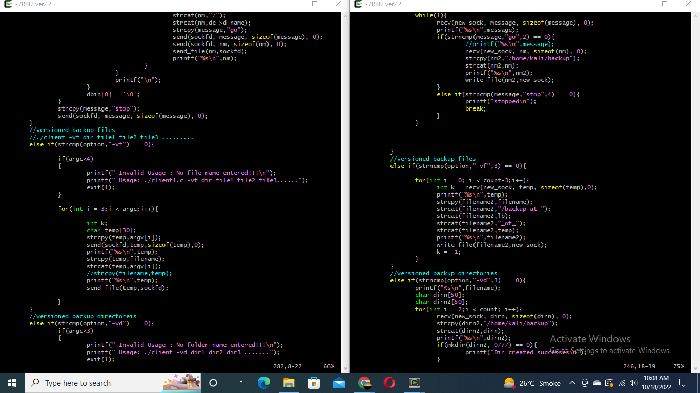
BRIEF DESCRIPTION OF CODE FOR VERSIONED-BACKUP(FILES)
./client.c [-vf] dir file1 file2 file3….
server
client

Slide 14
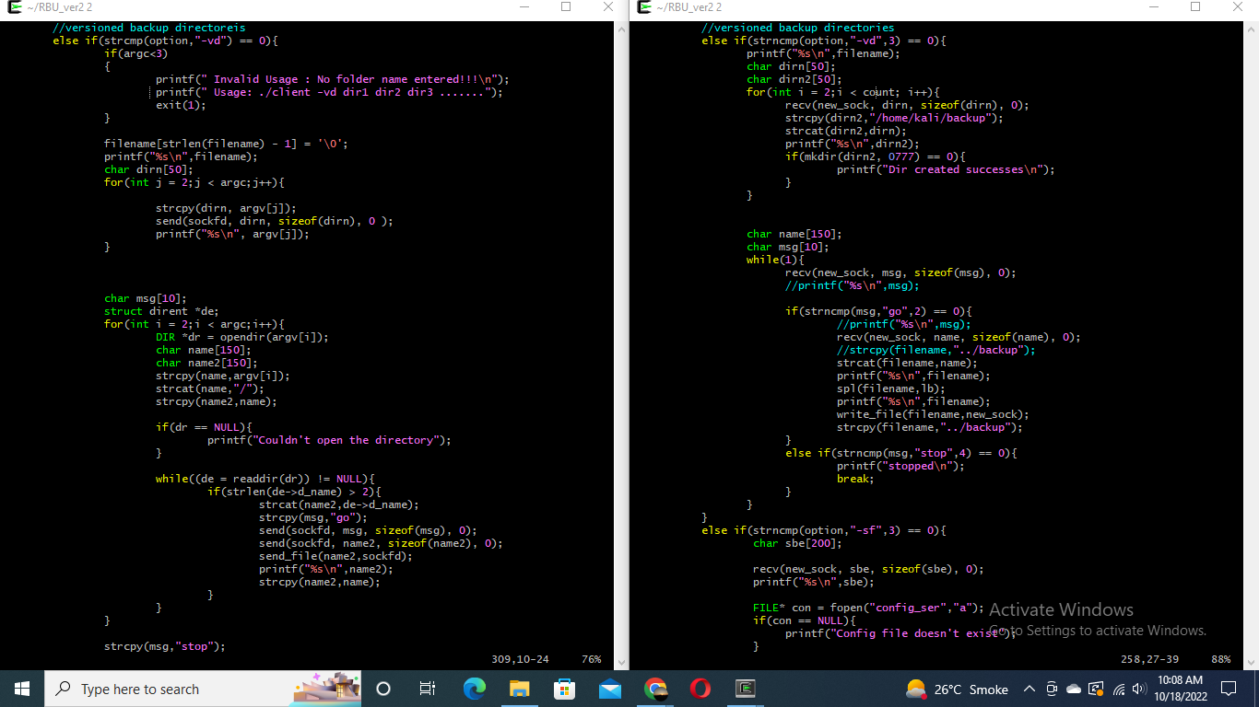
BRIEF DESCRIPTION OF CODE FOR VERSIONED-BACKUP(DIRECTORIES)
./client.c [-vd] dir1 dir2 dir3…
server
client

Slide 15
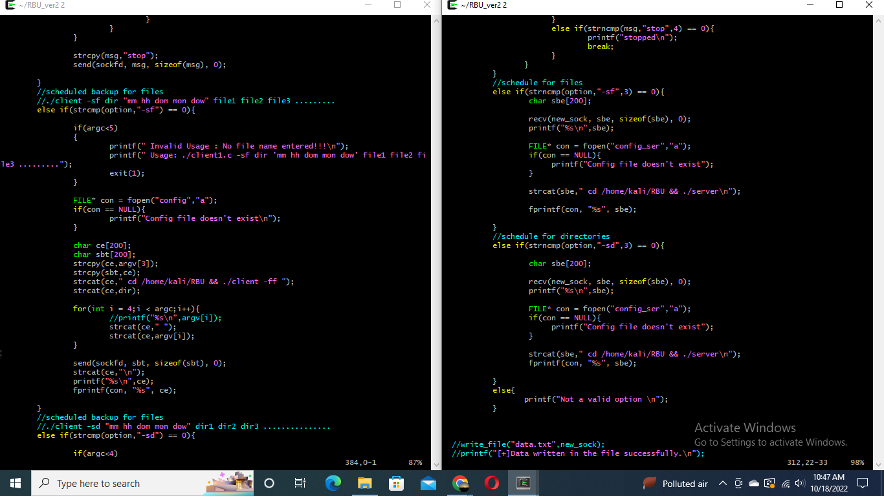
BRIEF DESCRIPTION OF CODE FOR SCHEDULED-BACKUP(FILES)
./client.c [-sf] dir ‘mm hh dom mon dow’ file1 file2
server
client

Slide 16
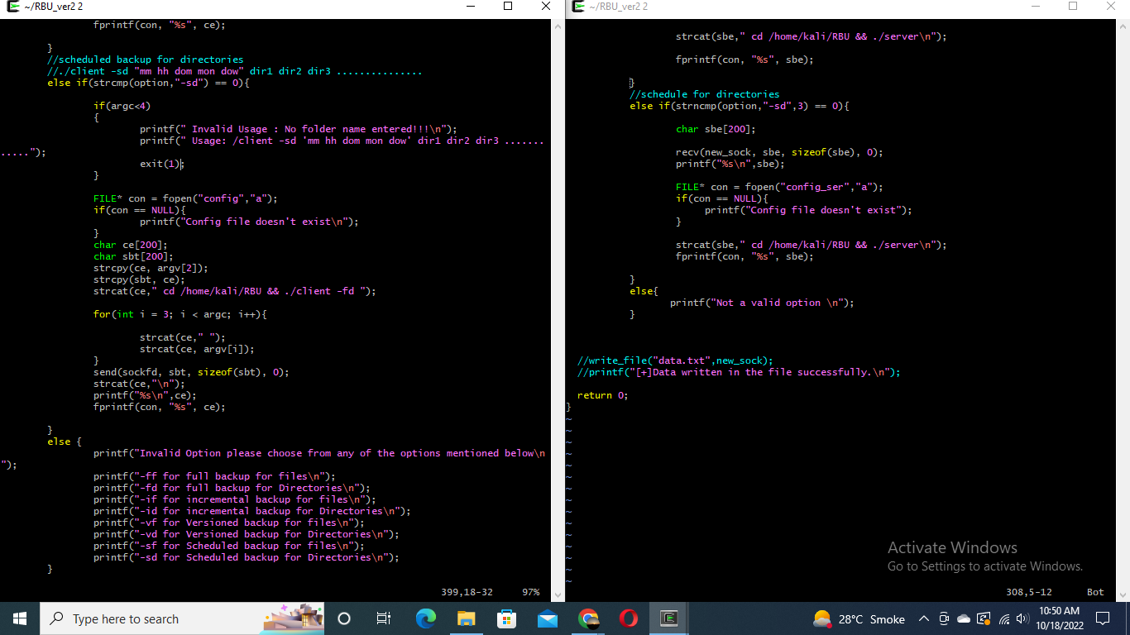
BRIEF DESCRIPTION OF CODE FOR SCHEDULED-BACKUP(DIRECTORIES)
./client.c [-sf] dir ‘mm hh dom mon dow’ file1 file2
server
client

Slide 17
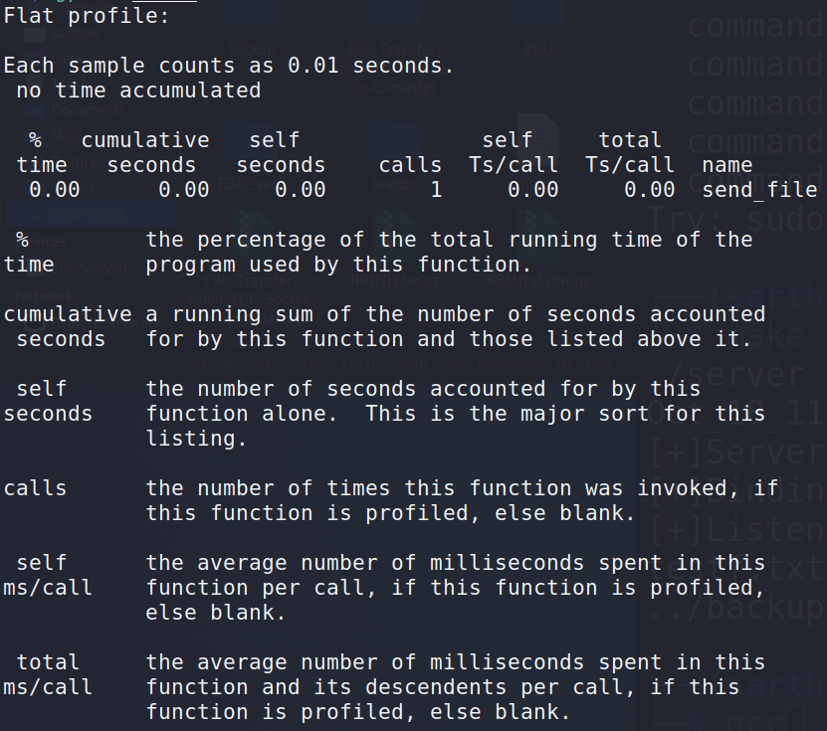
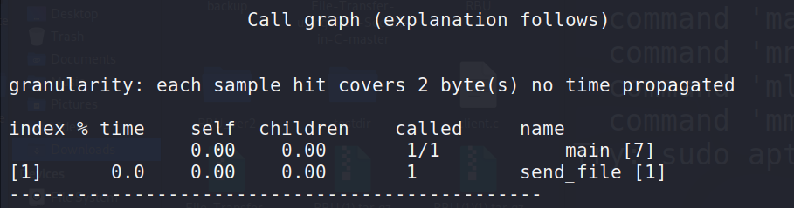
GProf for Client
Commands used:
gcc -pg client.c
gprof a.out
This table describes the call tree of the program and was sorted by the total amount of time spent in the function and its children.

Slide 18
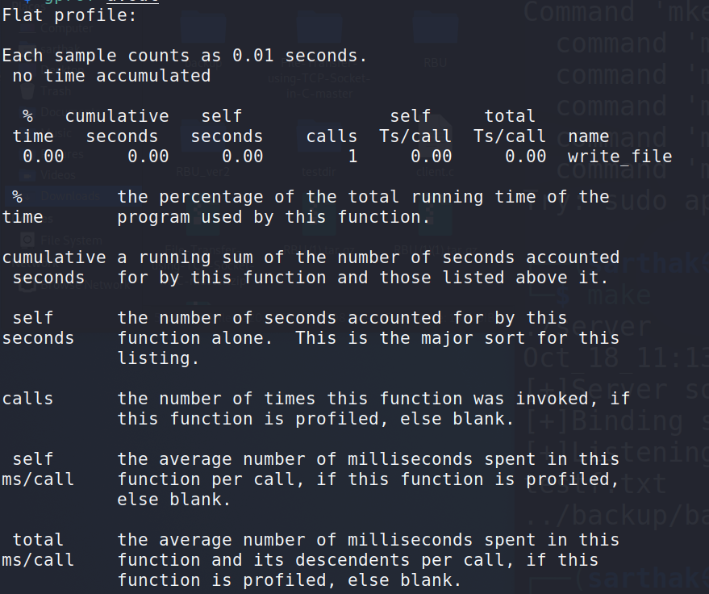
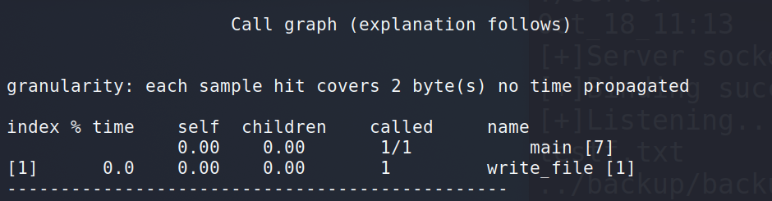
GProf for Server
Commands used:
gcc -pg server.c
gprof a.out
This table describes the call tree of the program and was sorted by the total amount of time spent in the function and its children.

Slide 19
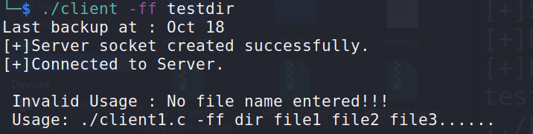
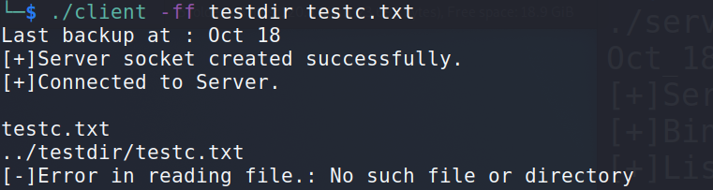
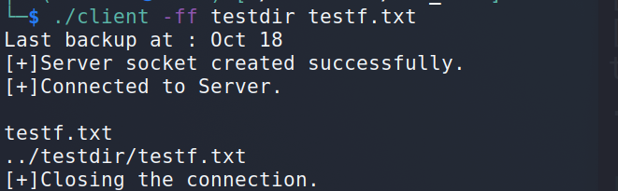
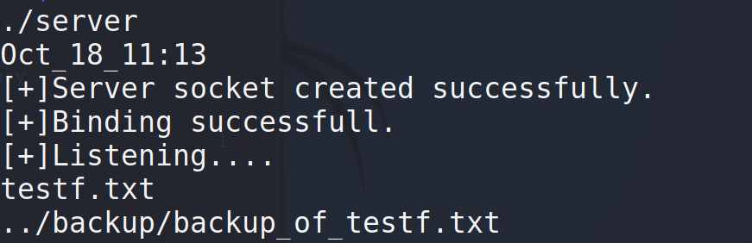
Integration Testing
When the user doesn’t provide any file name
When the user doesn’t provide the correct file name in the directory
When the user provides the correct file name in the directory

Slide 20
THANK YOU
-Shagir Husain -Aryan Tiwari -Prinshu Raj -Sarthak Srivastava -Sriram Repaka -Tushar Gautam

